Slide 1
Multimedia System and Virtual Environment
CSE – 310
Lecture 8
VIDEO
Dept. of Computer Science and Engineering, University of Rajshahi

Slide 2
Outline
Basic Video Properties
Signal Format
Analog and Digital Video
Chroma Subsampling
Interlaced/Progressive Scanning
Dept. of Computer Science and Engineering, University of Rajshahi

Slide 3
Basic Video Properties
Representation of Video Signals
Visual Representation
To present the observer with as realistic as possible a representation of a scene
Transmission of Video Signals
Television Systems
Video Digitization
Digital Television
Dept. of Computer Science and Engineering, University of Rajshahi

Slide 4
Visual Representation
In order to accurately convey both spatial and temporal aspects of a scene, the following properties are considered
Vertical Details and Viewing Distance
The geometry of a television image is based on the ratio of the picture width W to the picture height H (W/H), called the aspect ratio.
Conventional aspect ratio is 4:3.
The angular field of view is determined by the viewing distance, D, and is calculated as D/H.
Dept. of Computer Science and Engineering, University of Rajshahi

Slide 5
Visual Representation
Horizontal Detail and Picture Width
Can be determined from the aspect ratio
Total detail content of a picture
Since not all lines (horizontal and vertical) are visible to the observer, additional information can be transmitted through them.
Depth perception
Depth is a result of composing a picture by each eye (from different angles)
In a flat TV picture
Perspective appearance of the subject matter
Choice of focal length of the camera lens and changes in depth focus
Dept. of Computer Science and Engineering, University of Rajshahi

Slide 6
Visual Representation
Luminance
RGB can be converted to a luminance (brightness signal) and two color difference signals (chrominance) for TV signal transmission
Temporal Aspects of Illumination
A discrete sequence of still images can be perceived as a continuous sequence.
The impression of motion is generated by a rapid succession of barely differing still pictures (frames).
Rate must be high enough to ensure smooth transition.
Rate must be high enough so that the continuity of perception is not disrupted by the dark intervals between pictures
Dept. of Computer Science and Engineering, University of Rajshahi

Slide 7
Visual Representation
Continuity of Motion
Continuity is perceived with at least 15 frames per second.
To make motion appear smooth in a recorded film, a rate of 30 frames per second is needed.
Films recorded with 24 frames per second look strange when large objects close to the viewer move quickly.
NTSC (National Television Systems Committee) Standard
Original: 30 frames/second
Currently: 29.97 frames/second
PAL (Phase Alternating Line) Standard
25 frames per second
Dept. of Computer Science and Engineering, University of Rajshahi

Slide 8
Visual Representation
Flicker
If the refresh rate is low, a periodic fluctuation of the perceived brightness can result.
Minimum to avoid flicker is 50 Hz.
Technical measures in movies and TV have allowed lower refresh rates.
Dept. of Computer Science and Engineering, University of Rajshahi

Slide 9
Chrominance
Chrominance (chroma ) is the signal used in video systems to convey the color information of the picture, separately from the accompanying luma signal (or Y).
Chrominance is usually represented as two color-difference components: U = B − Y (blue − luma) and V = R − Y (red − luma).
Each of these difference components may have scale factors and offsets applied to it, as specified by the applicable video standard.
In composite video signals, the U and V signals modulate a color subcarrier signal, and the result is referred to as the chrominance signal.
The phase and amplitude of this modulated chrominance signal correspond approximately to the hue and saturation of the color.
In digital-video and still-image color spaces such as YC_{b}C_{r}, the luma and chrominance components are digital sample values.
Luma represents the brightness in an image (the "black and white“ portion of the image).
Dept. of Computer Science and Engineering, University of Rajshahi

Slide 10
Signal Formats
Computer Video Formats
Color Graphics Adapter (CGA)
Resolution: 320 x 200
2 bits / pixel
Enhanced Graphics Adapter (EGA)
Resolution: 640 x 350
4 bits / pixel
Video Graphics Array (VGA)
Resolution: 640 x 480
8 bits / pixel
Super Video Graphics Array (SVGA)
Resolution: 1024 x 768, 1280 x 1024, 1600 x 1280
8 bits / pixel
Dept. of Computer Science and Engineering, University of Rajshahi

Slide 11
Types of Video Signals
Component video
Three separate signals for tristimulus color representation or luminance-chrominance representation
Pro: higher quality, no cross talk
Con: need high bandwidth and synchronization
Composite video
Multiplex into a signal
Historical reason for transmitting color TV through monochrome channel
Pro: save bandwidth
Con: cross talk
S-video: luminance sig. + single multiplexed chrominance sig.
Pro: less color detail
Con: cross talk
Dept. of Computer Science and Engineering, University of Rajshahi

Slide 12
Color Coding: RGB
An RGB signal consists of separate signals for red, green, and blue.
Every color can be encoded as a combination of these three primary colors using additive color mixing.
The value of R, G, and B are normalized such that white results when R + G + B = 1 in the normalized representation.
Dept. of Computer Science and Engineering, University of Rajshahi

Slide 13

Color Coding: YUV
Y is luminance
UV are chrominance
YUV from RGB
Y =.299R+.587G+.114B U = 0.492 * (B - Y) V = 0.877 * (R - Y)
Y
U
V
Dept. of Computer Science and Engineering, University of Rajshahi

Slide 14

YC_{r}C_{b}
Subset of YUV that scales and shifts the chrominance values into range 0..1
Y = 0.299R + 0.587G + 0.114B C_{r} = ((B-Y)/2) + 0.5 C_{b} = ((R-Y)/1.6) + 0.5
Y
C_{r}
C_{b}
Dept. of Computer Science and Engineering, University of Rajshahi

Slide 15

YIQ
YIQ from RGB
Y = 0.299R + 0.587G + 0.114B I = 0.60R - 0.28G – 0.32B Q = 0.21R - 0.52G + 0.31B
Dept. of Computer Science and Engineering, University of Rajshahi

Slide 16
Analog Video
NTSC Video (National Television Standards Comittee)
Originated in the US
Uses color carriers of approx. 4.429 MHz or approx. 3.57 MHz.
With suppressed color carrier, it uses quadrature amplitude modulation
Refresh rate: 30Hz
# horizontal lines: 525
Aspect ratio 4:3
Dept. of Computer Science and Engineering, University of Rajshahi

Slide 17
Analog Video
SECAM Video (System Electronic Couleur Avec Memoire)
France and Eastern Europe
With suppressed color carrier, it uses frequency modulation
Refresh rate: 25Hz
# horizontal lines: 625
Dept. of Computer Science and Engineering, University of Rajshahi

Slide 18
Analog Video
PAL Video (Phase Alternating Line)
Parts of Western Europe
Uses color carriers of approx. 4.43 MHz
With suppressed color carrier, it uses quadrature amplitude modulation
Refresh rate: 25Hz
# horizontal lines: 525
Dept. of Computer Science and Engineering, University of Rajshahi

Slide 19
Digital Video
Advantages:
Storing video on digital devices ready to be processed (noise removal, cut and paste, and so on) and integrated into various multimedia applications.
Direct access which makes nonlinear video editing simple
Repeated recording without degradation of image quality
Ease of encryption and better tolerance to channel noise
Dept. of Computer Science and Engineering, University of Rajshahi

Slide 20
High-Definition TV (HDTV)
Research began in Japan, 1968
Third Technological Shift (after black and white and color TV)
The goal was to “integrate” the viewer with the events happening on the screen
Resolution
More than 1000 scanning lines
Approximately double the resolution of conventional TV
Higher video bandwidth
About five times that of conventional TV
Resolutions Recommended
High 1440 Level: 1440 x 1152
High Level: 1920 x 1152
Later, 2k x 2k pixels
Dept. of Computer Science and Engineering, University of Rajshahi

Slide 21
High-Definition TV (HDTV)
Frame Rate
No agreement on a fixed frame rate worldwide
50 or 60 frames per second
Aspect Ratio
Originally 16:9
Currently 4:3
Interlaced and/or progressive scanning formats
Conventional systems supported interlaced scanning formats
HDTV supports both.
Viewing Conditions
Screen area should be bigger than 8000cm² for “real” scenes
Dept. of Computer Science and Engineering, University of Rajshahi

Slide 22
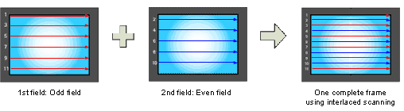
Interlaced Scanning
Developed for Cathode Ray Tube (CRT)-based TV monitor displays
Made up of 576 visible horizontal lines across a standard TV screen.
Interlacing divides these into odd and even lines and then alternately refreshes them at 30 frames per second.
The slight delay between odd and even line refreshes creates some distortion or 'jaggedness'. This is because only half the lines keeps up with the moving image while the other half waits to be refreshed.
Dept. of Computer Science and Engineering, University of Rajshahi

Slide 23
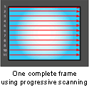
Progressive Scanning
Progressive scanning scans the entire picture line by line every sixteenth of a second.
Computer monitors do not need interlace to show the picture on the screen, so there is virtually no "flickering" effect.
Dept. of Computer Science and Engineering, University of Rajshahi

Slide 24
Chroma Subsampling
Since human see color with much less spatial resolution than black and white, it makes sense to decimate the chrominance signal.
Here label numbers are given stating how many pixel values, per four original pixels, are actually sent.
Chroma subsampling scheme “4:4:4” indicates that no chroma subsampling is used.
Dept. of Computer Science and Engineering, University of Rajshahi

Slide 25
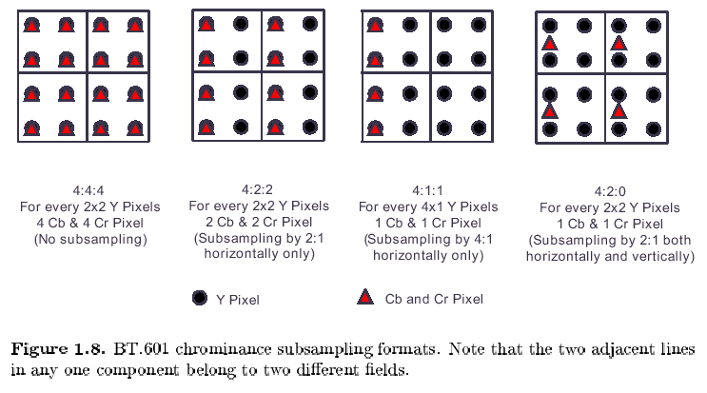
Chroma Subsampling
Dept. of Computer Science and Engineering, University of Rajshahi

